Slide 1

Task 1.10: User Stories
By: Minal Bombatkar

Slide 2
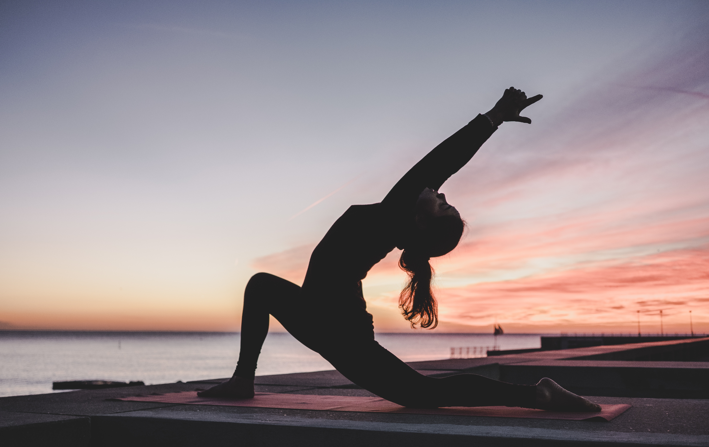

ONBOARDING / LOG IN
As a new user, I want an engaging onboarding experience that focuses on my needs, so that when I am finished, my initial interaction with the application will be catered to my interests and needs.
As an yoga expert, I need to make an account so that I can keep track of my call history and profile.

Slide 3


PERSONALIZING PROFILE
As a user, I want to have a profile so that yoga experts can see who I am in order to help me to the best of their ability.
As an yoga expert, I would like to be able to show my availability so that users can expect when I can respond or call.
As an yoga expert, I want to have a description that shows my credentials and summary of my experience.

Slide 4
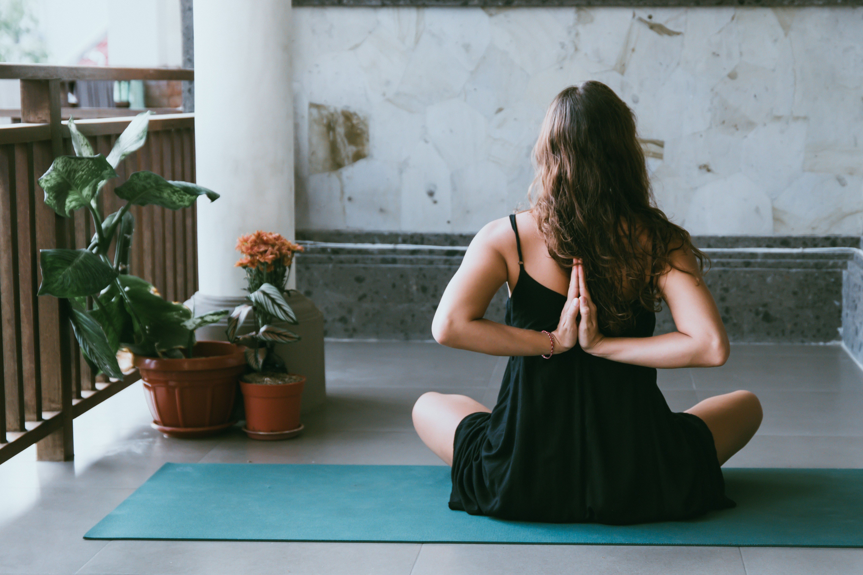

SEARCHING
As a user, I want to be able to search for a yoga expert so that I can get help on my questions.
As a user, I want to be able to browse list of yoga experts.
As a user, I want to be able to narrow my browsing to specific filters like expert availability and highest rating so that I can find the expert best suited.
As a yoga expert, I want to be able to reach out to a clients, through questions posted by users so that I can answers those questions.

Slide 5
EXPERT PROFILES
As a user, I would like to look at expert profiles to know more about who they are before I talk to them.
As a user, I want to see reviews of the all yoga experts in order to know how well they give advice.
As a yoga expert, I need to be able to update and change my profile in order to keep up with my changing experience and availability.

Slide 6

BOOKING APPOINTMNET
As a user, I want to able to book appointment so that I get personal expert guidance and would receive the conformation from expert.
As an yoga expert, I would like to be able accept or reject the appointment as per my availability so that users can get conformation/ rejection message.

Slide 7

TALKING TO AN EXPERT
As a user, I would like to be able to see the yoga expert’s availability so that I can call when convenient.
As an yoga expert, I want to have a way to talk to the user on the app so that I don’t need to give up personal contact information.

Slide 8

PAYING FOR CALL
As a user, I want to be able to see the price before I talk to an yoga expert so that I know what price to expect.
As an yoga expert, I want a place to see all of my call history to keep track of payments.

Slide 9
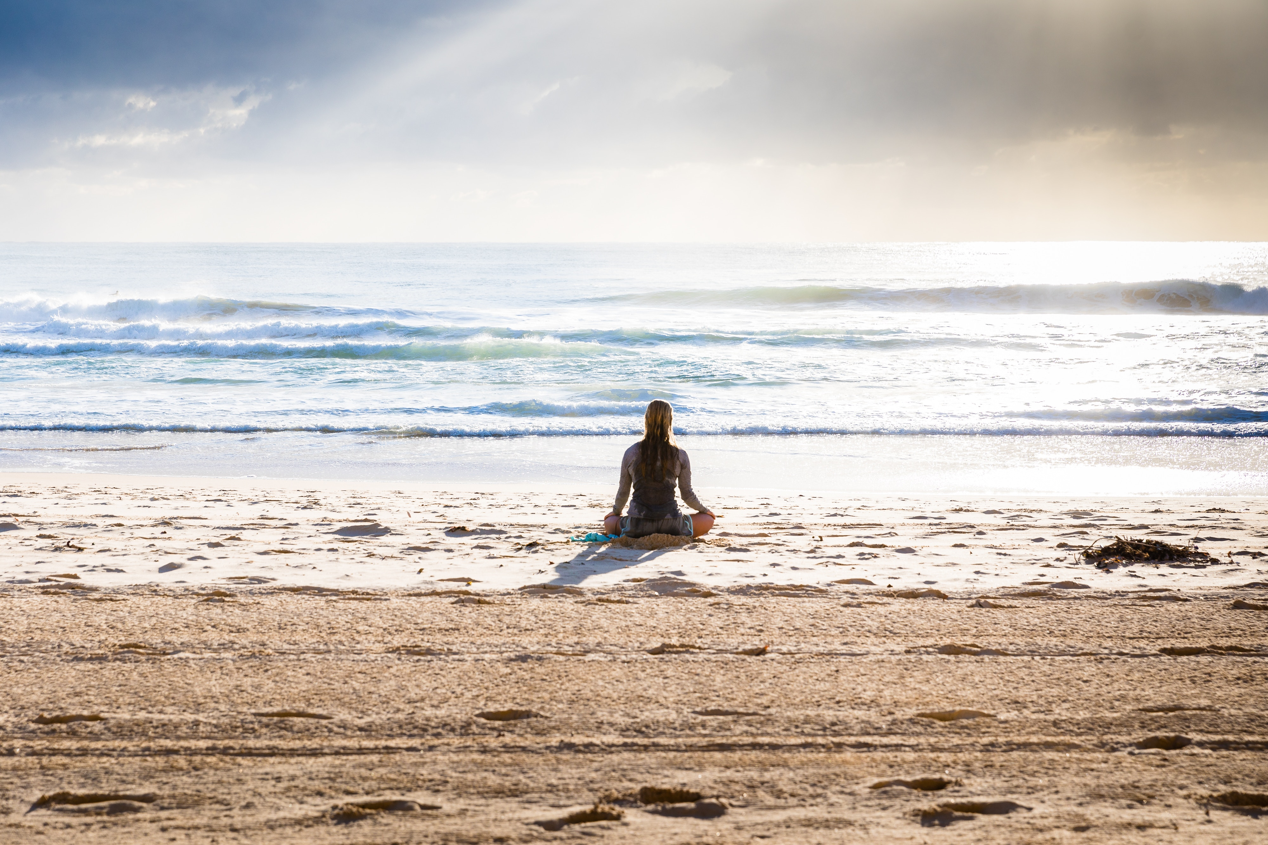

LEAVING A REVIEW
As a user, I would like to be able to review the yoga expert following the call so that I can give honest feedback to promote a trustworthy environment.
As an yoga expert, I would like to be able to comment on a user’s review so that it will help to satisfy the user and scope for improvement in my service

